Slide 1
Git Branching Strategies
Victor Grazi - DevOps

Slide 2



Works every time!

Slide 3
Continuous Integration Timeline
Prehistorically – Developers manually built code and delivered it to a human integrator
every 3 months integrator would manually ”integrate” everyone’s work
a grueling, tortuous process!
1994 – Grady Booch writes Object-Oriented Analysis and Design with Applications
uses the phrase “continuous integration” to explain how "internal releases represent a sort of continuous integration of the system"
1997 – Kent Beck and Ron Jeffries invented Extreme Programming (XP) while on the Chrysler Comprehensive Compensation System project, including continuous integration
1999 – Beck elaborates on continuous integration in his first full book on Extreme programming, emphasizing importance of face-to-face communication
2001 – CruiseControl released - the first CI/Build server
2005 – Linus Torvalds creates Git while developing Linux to address SVN shortfalls
2009 – Martin Fowler publishes his popular blog posting on feature branching https://martinfowler.com/bliki/FeatureBranch.html
2012 – Vincent Driessen introduces Gitflow

Slide 4
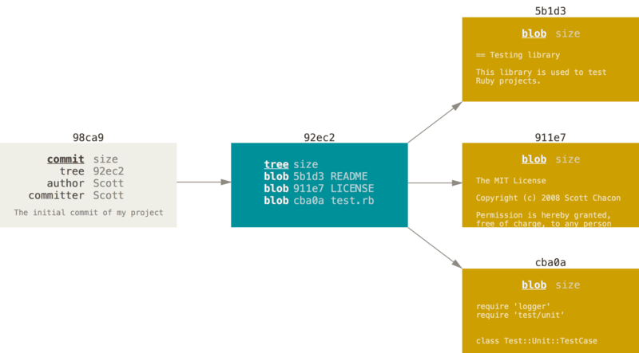
Git - What’s a commit?
A commit consists of:
“Blob” objects for each file in that commit
A ”Tree” object pointing to those blobs,
A “Commit” object that points to that tree
$ git cat-file –p 92ec2
tree 1d97b9a335ec
parent 639a1cde8e
author Victor Grazi
committer Victor Grazi

Slide 5
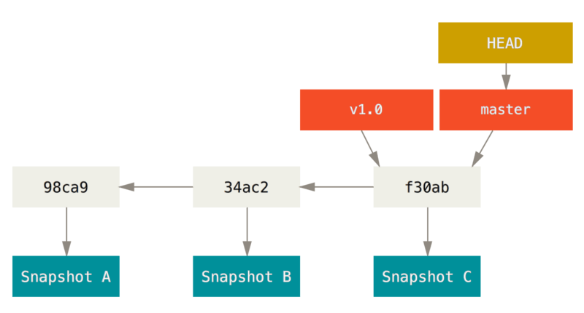
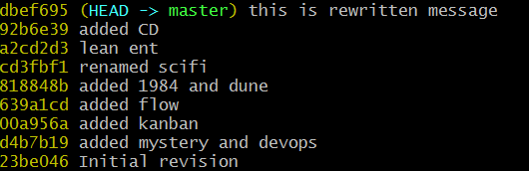
What’s a branch?
Head points to the current branch
A branch is simply a pointer to a commit:
$ git log --oneline --decorate
Notes:
because a branch is just a pointer, it is very cheap to create and destroy.
This should encourage developers to do so often
Give your branches a name that include both your JIRA and a brief description

Slide 6
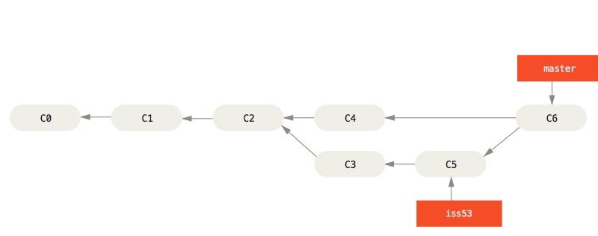
Merging branches creates a new commit
$ git merge --no-ff

Slide 7
Git branch commands
$ git branch -v scifi 93b412c fix javascript issue
* master 7a98805 Merge branch ‘scifi'
testing 782fd34 add f451
Branches without a ‘*' are fully merged and may be deleted safely

Slide 8
Merge
Rebase
’
’
’
m5
v3
v3
m4
m4
v2
v2
Time
m3
m3
v1
v1
m2
m2
m1
m1
master
my-branch
master
my-branch
$ git checkout my-branch
$ git merge master
$ git checkout my-branch
$ git rebase master

Slide 9
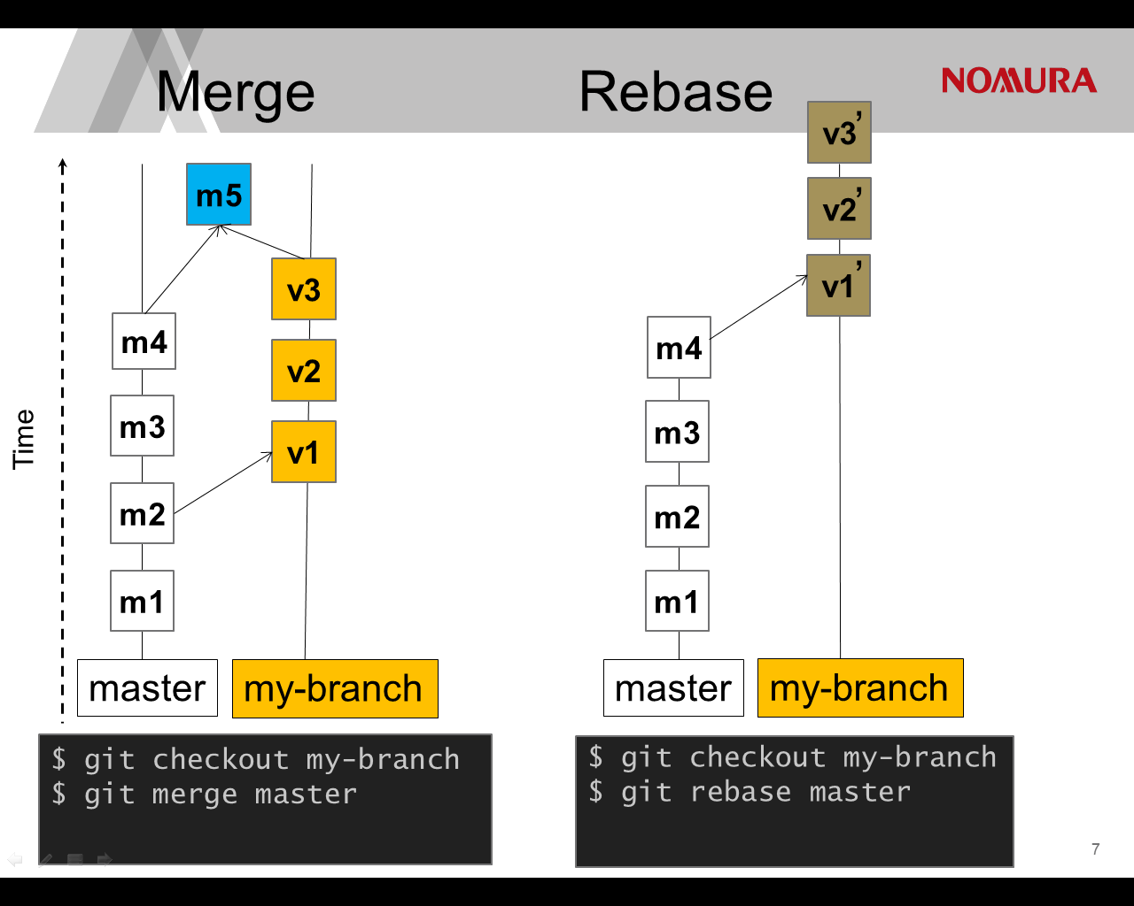

Slide 10
Cherry-pick
’
’
’
Under Construction
v3
m4
v2
Time
m3
v1
m2
m1
master
my-branch
$ git checkout my-branch
$ git rebase master

Slide 11
Why Branch?
You’re building a new application feature
Do some work on a feature
Create a branch for that feature
Do more work on that branch
Stuff happens…. need to work on a critical prod issue
Checkout prod branch
Create a branch for the fix
Test, merge, release
Switch back to the original branch and continue

Slide 12
Why Branch?
Or, you’re working on a feature,
you don’t want to push it to mainline until it is relatively stable,
but you do want to commit frequently.

Slide 13
Requirements of Collaborative Development
“Everyone commits to the mainline every day.” (The fundamental rule of continuous integration)
Resolve code conflicts early
Don’t let different branches generate the same snapshot version
Git is not just a VCS, it is a development tool

Slide 14
Which Branching Strategy? Decision points
Does you current strategy work? If it ain’t broke, don’t fix it!
otherwise…. consider – what’s broken, make small change then look again!
Number of active versions
Team size
Degree of collaboration
Regional distribution
Volatility
Modularization of codebase

Slide 15
Centralized Work (no branches)
master
Create Release Tag 1.0.0
Time
Create Release Tag 1.0.1
Create Release Tag 1.1.0
Jenkins
Notes:
This is a great approach for a large development team that is coming off of SVN, and has not yet become accustomed to the simplicity of Git branching.
It has the following merits
Developers know they have to commit frequently
You never fall behind because you pull very frequently (i.e. before every commit!)
Conflicts are detected early, which is the easiest time for them to be corrected
Developers know that their commits are impacting everyone so it promotes good citizenship
You get continuous integration, there is no confusion about build versions
Downside
Everything is comingled, so it is difficult to review your own feature changes in isolation
There is no feature segregation, so you can’t easily decide which features to include in the next release and which to defer.

Slide 16
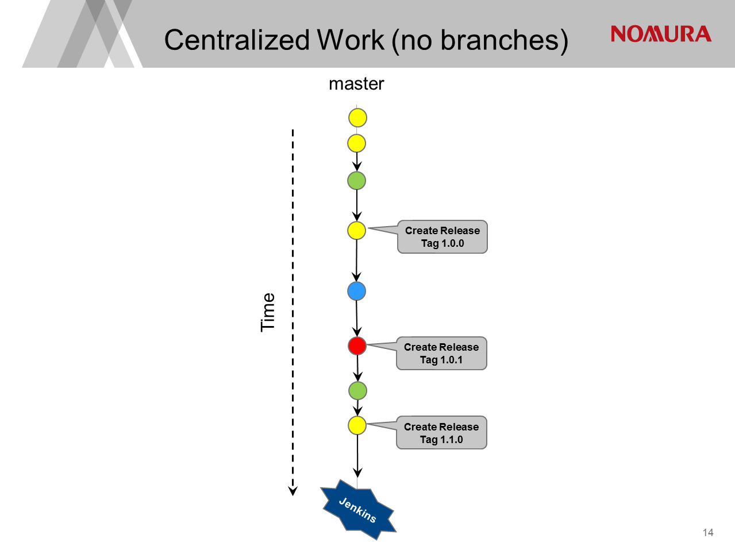
Notes:
This is a great approach for a large development team that is coming off of SVN, and has not yet become accustomed to the simplicity of Git branching.
It has the following merits
Developers know they have to commit frequently
You never fall behind because you pull very frequently (i.e. before every commit!)
Conflicts are detected early, which is the easiest time for them to be corrected
Developers know that their commits are impacting everyone so it promotes good citizenship
You get continuous integration, there is no confusion about build versions
Downside
Everything is comingled, so it is difficult to review your own feature changes in isolation
There is no feature segregation, so you can’t easily decide which features to include in the next release and which to defer.

Slide 17
Merits
Useful for large teams coming off SVN, not yet accustomed to the simplicity of Git branching.
Developers commit frequently
You must pull very frequently (i.e. before every push!) so conflicts are detected early, which is the easiest time for them to be corrected
Master must be stable - developers know that their commits are impacting everyone so it promotes good citizenship
You get continuous integration, there is no confusion about build versions
Downside
Difficult to maintain different versions concurrently
Everything is comingled, difficult to review your feature changes in isolation
No feature segregation, difficult to decide which features to include in release and which to defer.
Centralized Work (no branches)

Slide 18

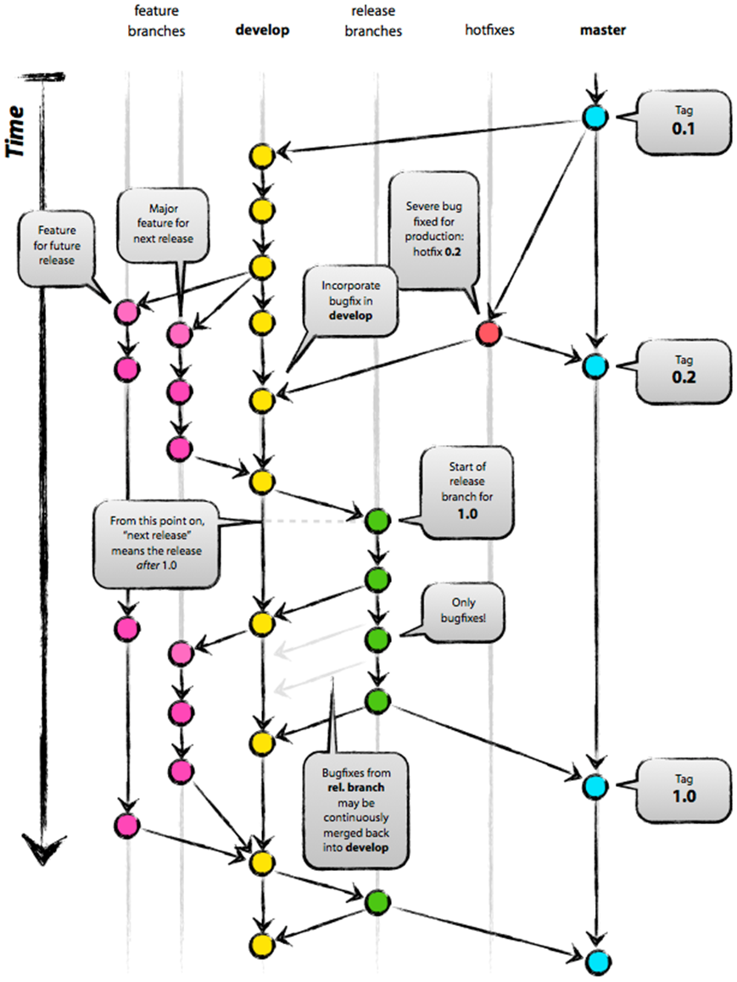
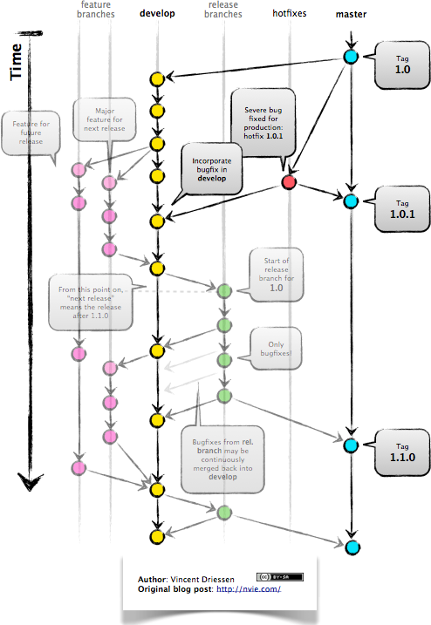
GitFlow - by Vincent Driessen - January 2012
http://nvie.com/posts/a-successful-git-branching-model/
1.0.1
1.1.0
1.1.0

Slide 19
Gitflow
feature
branches
develop
(unstable)
release
branches
hotfixes
master
(stable)
Tag 1.0.0
Feature for future release
Major feature for next release
Start of release branch for 1.1.0
Time
Bug fixes from ‘release’ are continuously merged back into ‘develop’
When ready, merge release back into master and develop
Bug fixes go directly on ‘release’
Create Tag 1.1.0
(Patch release)
Severe bug fixed hotfix 1.1.1
Create Tag 1.1.1
(Patch release)
Jenkins
snapshots
Jenkins
releases
18
Notes:
Master tracks the official release history. When you start, branch a develop branch off master
Develop is “unstable”, an integration branch for new features
When a feature is complete, merge it back into the develop branch
When it is time for a release, a release branch is created from develop
UAT testing is performed on the release
Then continue to build, deploy and fix until happiness
Creating and resetting branches are easy!
Challenges with this approach:
Builds aren’t configured to run on feature branches.
Conflicts materialize on the develop branch, and you won’t notice them until you pull and merge the feature.

Slide 20
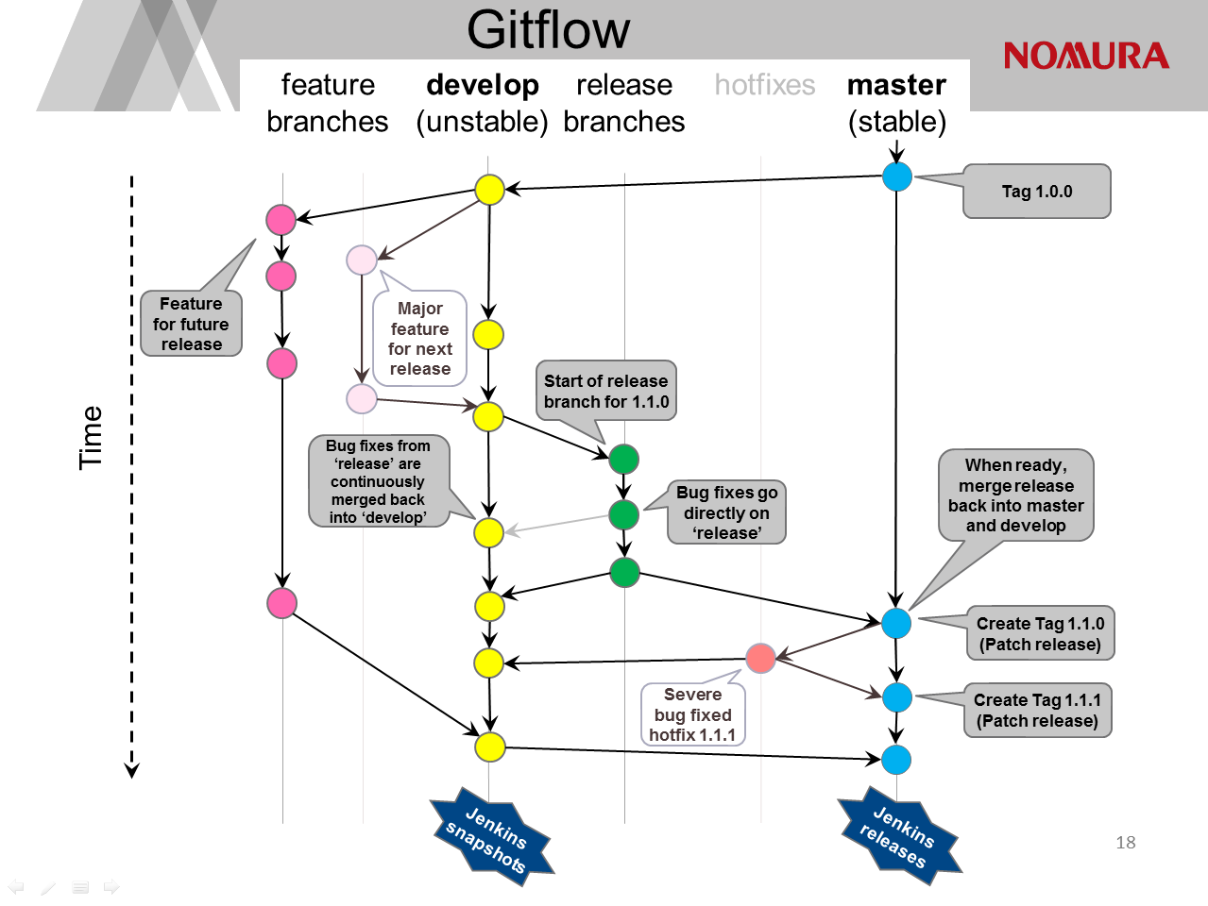
Notes:
Master tracks the official release history. When you start, branch a develop branch off master
Develop is “unstable”, an integration branch for new features
When a feature is complete, merge it back into the develop branch
When it is time for a release, a release branch is created from develop
UAT testing is performed on the release
Then continue to build, deploy and fix until happiness
Creating and resetting branches are easy!
Challenges with this approach:
Builds aren’t configured to run on feature branches.
Conflicts materialize on the develop branch, and you won’t notice them until you pull and merge the feature.

Slide 21
Gitflow
Merits
Features are isolated easy to manage your own feature changes in isolation
Easy to maintain different versions
Feature segregation, lets you decide which features to include in release.
Downside
You lose the notion of continuous integration since changes are maintained on feature branches
Or you build snapshots off every feature branch, causing ambiguous binaries for a given pom version
Notes:
Master tracks the official release history. When you start, branch a develop branch off master
Develop is “unstable”, an integration branch for new features
When a feature is complete, merge it back into the develop branch
When it is time for a release, a release branch is created from develop
UAT testing is performed on the release
Then continue to build, deploy and fix until happiness
Challenges with this approach:

Slide 22
Summary
Git branching is simple, collaboration is not
If what you’re doing works, stay with it
If not, tweak it, try it, and revise as necessary
Remember the rules:
Merge to master often to minimize conflicts
Integrate often
Keep your mainline “master” stable!
Don’t let different branches generate the same snapshot version

Slide 23
References
Git Workflows a la carte - http://bit.ly/gitalacarte
Git Flow - original post http://bit.ly/git-flow-nvie
Gitflow Extension: http://github.com/nvie/gitflow
https://www.atlassian.com/git/tutorials/comparing-workflows
www.atlassian.com/git
http://atlassian.com/continuous-delivery
https://martinfowler.com/bliki/FeatureBranch.html
Frank Booth survey: http://gm-dev-tools.nomura.com/ETCB/confluence/display/JIDOKA/A+swift+introduction+to+established+git+dev+patterns

